Slide 1
Establish, Grow or Reignite Planned Giving in Your Organization
Jeff Grandy, Vice President of Client Development
Catapult Fundraising, Inc.
jeffg@catapultfr.com

Slide 2
Today’s Top 5
Recognizing Intent
Donor Communication
Indicators of Planned Giving Capacity
Internal Infrastructure
After-life Gift Processing

Slide 3
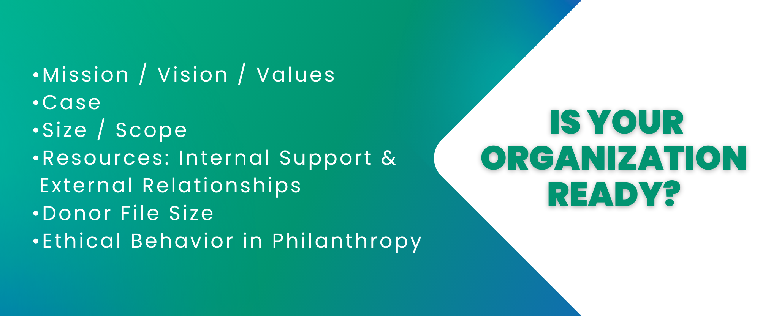
Is Your Organization Ready?
Mission / Vision / Values
Case
Size / Scope
Resources: Internal Support & External Relationships
Donor File Size
Ethical Behavior in Philanthropy

Slide 4
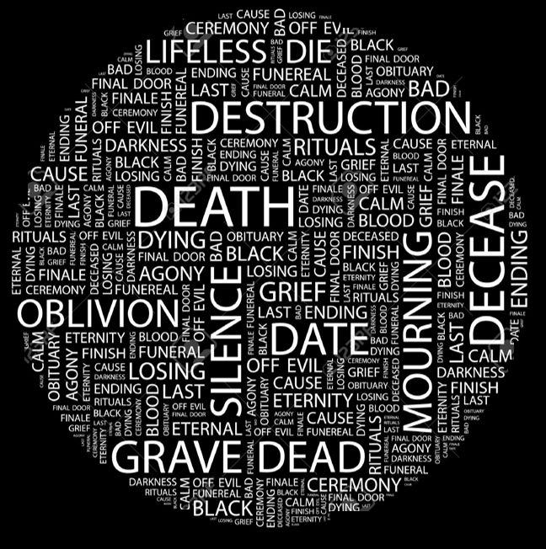

Slide 5
The 4 - Right Rule
The right person
Asking the right prospect
For the right amount
At the right time

Slide 6
How to Identify Planned Giving Donor Prospects
Identification:
Age
Affinity
Loyalty
Giving History
Family Members
Wealth Capacity Ratings

Slide 7
How to Build the Pipeline? – Legacy Call
Thank loyal donors
Identify interest
Explore gift planning options
Confirm & quantify planned gifts

Slide 9
Recognizing Intent
Communication & Engagement
Legacy Planning
Processing
Stewardship Gratitude
Donor Cycle

Slide 10
Getting Started
Planned Giving Solicitation Kit
Traditional Components
Folder/Jacket: Branded accordingly
Case for Support with tailored Case Statement
About Us History and Timeline
Organization Leadership: Staff, Board, Advisors
Programs
FAQ
Planned Giving Components
PG Case Statement
PG Ways To Give
PG Program: Society Benefit
Gift Designation Instructions
Gift Intention Form
PG Donor Testimonial

Slide 11
Determining Capacity & Interest
Taking time to cultivate
Building a trusting relationship
Solve problems
Gifting strategies

Slide 12
Gift Options – Level 1
Bequests / Beneficiary / Remainder
Life insurance
Retirement policy
Gift annuity

Slide 13
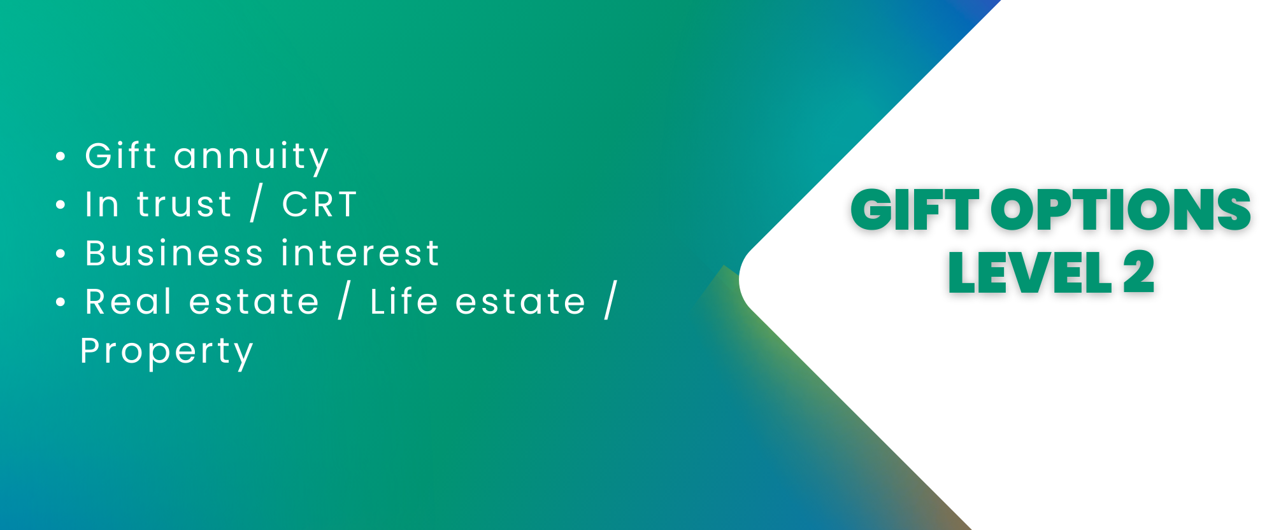
Gift Options – Level 2
Gift annuity
In trust / CRT
Business interest
Real estate / Life estate / Property

Slide 15
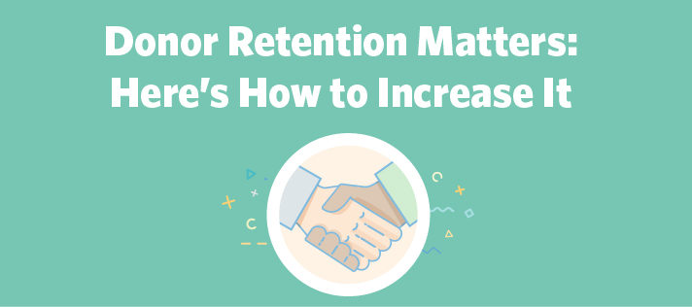

Slide 16
What Happens when the Donor Passes Away?
Expressing condolences
What is your goal?
The reason you follow-up?
How much information do you need?

Slide 17
Planned Giving – Annual Planning
Objective: Estate, Endowment, etc
Goal: Participation or Monetary
Team Support
Marketing Efforts
Development Efforts
Evaluation
What happens if you lose control of the plan?

Slide 18
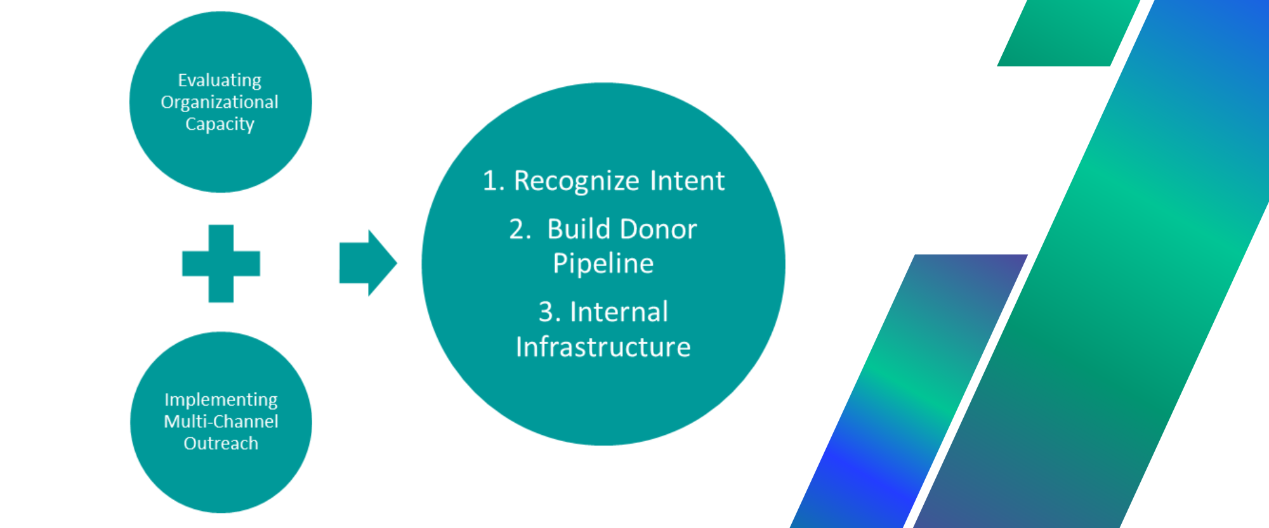
Evaluating Organizational Capacity
Implementing Multi-Channel Outreach
1. Recognize Intent
2. Build Donor Pipeline
3. Internal Infrastructure

Slide 19
Thousands of loyal donors are just waiting for you to ask…

Slide 20
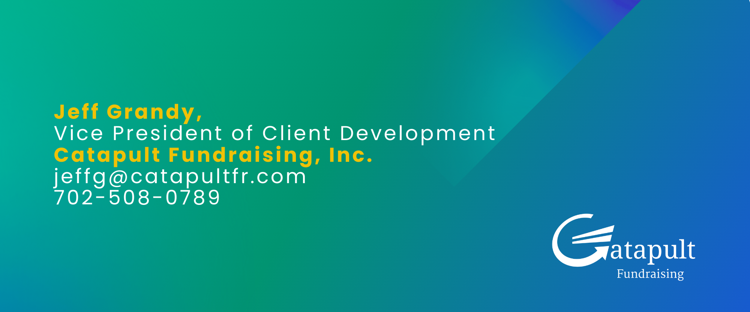
Questions?
Jeff Grandy
Vice President of Client Development
Catapult Fundraising, Inc.
jeffg@catapultfr.com
702-508-0789

